Slide 1
Chipotle clustering challenge

Slide 2
Chipotle store locations

Slide 3
Dendrogram (top 3 levels)

Slide 4
Clustering with Gaussian Mixture Model

Slide 5
Clustering DBSCAN

Slide 6
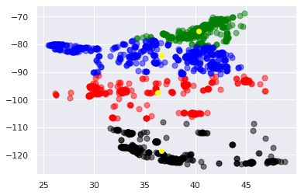
Clustering with K-Means (4 cluster)

